Slide 1
Iterator
Abdelrahman Osama
Eslam afify

Slide 2
iterator
Is a behavioral design pattern that lets you access elements of a collection without exposing its underlying representation (list, stack, tree, etc.).
Notes:
An iterator pattern is a method that provides a way to sequentially access individual elements of an aggregate object without exposing the internal representation of the object.

Slide 3
Problem
But how do you sequentially access elements of a complex data structure, such as a tree?

Slide 4
Solution
Separates the iterative process from the business logic. After using the iterator pattern, each element can be accessed sequentially, even if it doesn't care about the internal construction of the object. JavaScript has a lot of iterators built in, like forEach(), map(), filter(), some(), every().

Slide 5
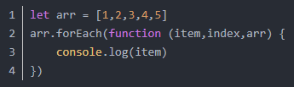
Internal iterator

Slide 6
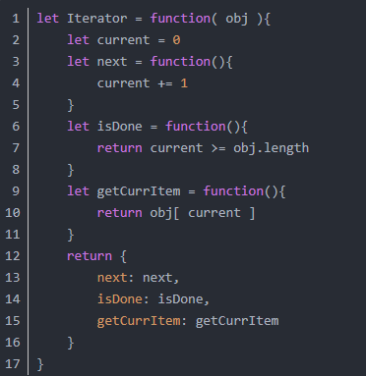
External iterator

